Slide 1

IBM Capstone project
COFFEE SHOP– MUMBAI
SAMIR MULANI

Slide 2

introduction
The city of Mumbai consists of a large number of coffee, but still scope for new ones.
Finding a suitable location for it to flourish is the most important factor for a coffee shop.
It has to be set up in a location where one can attract a good crowd as well as it must be located in an area where there is little or no competition.

Slide 3
data
The data that will be used in this projects is a csv file having data related to all neighborhoods in the city of Mumbai. Getting from Wikipedia page of Mumbai neighborhoods
Finding a suitable location for a coffee shop.
We explore the neighborhoods using Foursquare API to find the avenues within 1000 meters of each neighborhood.
The Foursquare API that will be used to explore the neighborhoods is https://api.foursquare.com/v2/venues/explore.
This API returns json response which will be transformed into a Data Frame, taking only the required details into consideration.

Slide 4
Methodology
Using the Foursquare API venue information is obtained in nearby vicinity of locations in Mumbai.
A radius is set to cover large neighborhoods in a particular area in Mumbai.
Getting lag lat data from geolocator.
This data is then merge with the neighborhoods dataset and a clustering algorithm is applied to the data.
K-Means Clustering : The data points are clustered into 4 clusters using K-Means algorithm.

Slide 5
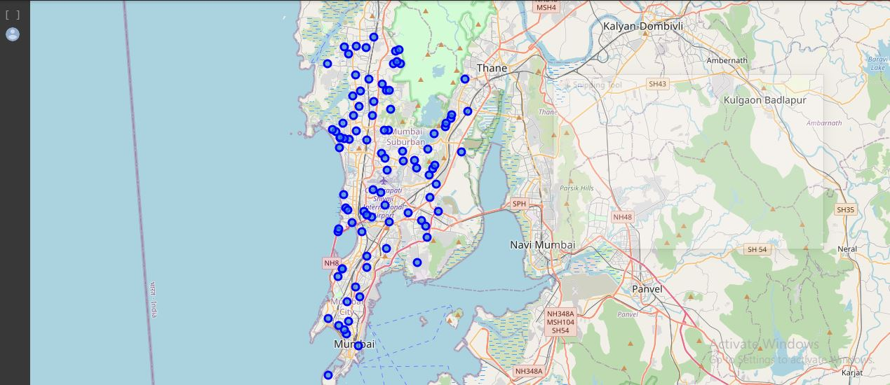
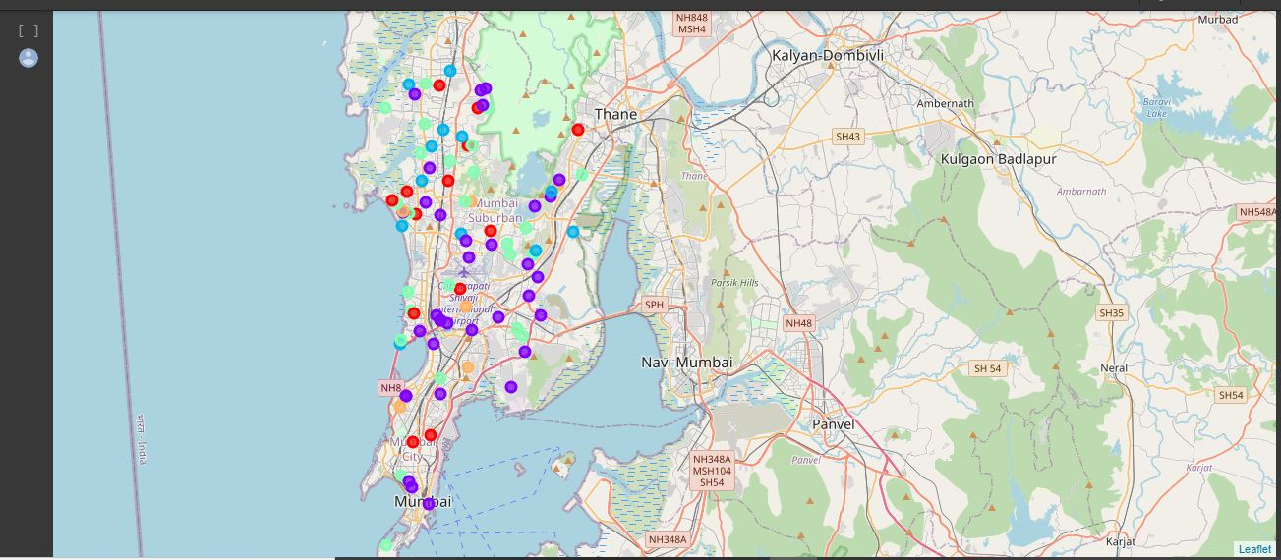
results
By exploring the requirements we found only two neighborhoods that match the requirements.

Slide 6
Conclusion & discussion
According to results we observe that most common venues (Top 10) come out to be restaurants and café, coffee shape and like Snack places, which means any new chef/business man can start a restaurant provided that they need to compete with existing restaurants (Other Types) but only if he provides top class facilities to get to top.
Based on the both Clusters formed it would be a good idea to open a new coffee shop in Clusters 0 or 1 & 2 since the other clusters already have coffee shop and Restaurants in their vicinities. cluster 0 and "NAN" value having no competition has possibility is there people are not interested at coffee shop.
cluster 1 & 2 have many restaurants in the vicinity (Pizza restaurants, European, Intercontinental, Indian) so one will be able to attract a good crowd.

Slide 7
Thank you

